Slide 2
Object Hierarchy
window
history
document
location
link
link
anchor
layer
form
applet
image
area
text
radio
button
fileUpload
select
textarea
checkbox
reset
option
password
submit

Slide 3
Objects in JavaScript
An object is a complex type of variable that contains its own variables (properties), and has its own functions (methods)
Properties
The variables of an object
Can also be other objects
Methods
The functions that belong to an object
e.g. document.bgColor, window.location
You can also define your own objects

Slide 4
Objects
window - the current browser window
window.history - the Netscape history list
window.document - the html document currently in the browser client area
window.location - the browser location field
window.toolbar - the browser toolbar
window.document.link - an array containing all of the links in the document
window.document.anchor - an array of all the anchor points in the document

Slide 5
Objects (more…)
Window.document.layer - a named document layer
window.document.applet - a named java applet area
window.document.image- a named image tag
window.document.area - a named area
window.document.form - a named form or the default form
ect, ect

Slide 6
A few examples...
window.location = “http://www.yahoo.com”
will take you to the specified URL (like a goto)
window.history.back()
back() is a method on history
will be like clicking the back button in Nav 3
in Nav 4 will take you back to prev window
window.history.goto(1)
takes you back to first URL in history array

Slide 7
The Object Model
It is very important to understand the object model
each object has its own properties, some of which are read only some of which you can set directly by assignment (as location)
each object also has a set of behaviors called methods

Slide 8
Object Model
Text Object
HTML text tag
=
B l u r ()
defaultValue
form
name
type
value
Select()
focus()
Red - gettable and settable
handleEvent

Slide 9
Object Event Handlers
Most objects respond to asynchronous, user generated events through predefined event handlers that handle the event and transfer control to a user written event handling function
Each object has particular events that they will respond to
the way you specify an event handler is by adding an additional attribute to the HTML tag that specifies the particular handler
<input name=bt1 type=button value=ok onClick=“acb();”>

Slide 10
Events
onAbort
onBlur
onChange
onClick
onError
onFocus
onLoad
onMouseOut
onMouseOver
onReset
onSelect
onSubmit
onUnload

Slide 11
onAbort
Activated when a user aborts the loading of an image
<img name=ball src=images/ball.gif onAbort=“alert(‘You missed a nice picture’)”>

Slide 12
onBlur
Used with frame, select, text, textarea and window objects
invoked when an object loses the focus
use with select, text and textarea for data validation

Slide 13
onChange
Used with select, text and textarea objects
use instead of onBlur to validate only if a value has changed
<form>
Color: <select onChange=“processSelection()”>
<option value=“R”>Red
<option value=“G”>Green
<option value=“B”>Blue
</select>
</form>

Slide 14
onClick
Used with button, checkbox,link, radio, reset, and submit objects.
<input type=button name=btn1 value=“Click Me” onClick=“alert(‘button was clicked’;” >

Slide 15
onError
Used with image and window objects to invoke a handler if an error occurs while an image or window is loading.
Setting window.onerror = null will prevent users from seeing JavaScript generated errors

Slide 16
onFocus
Used with frame, select, text, textarea and window objects.
Just the opposite of onBlur; i.e. invoked when the object gets focus.
<body bgcolor=“lightgrey” onBlur=“document.bgColor=‘black’ onFocus=“document.bgColor=‘white’” >

Slide 17
onLoad
Used with window, frame and image objects (use with <body ….><frameset ….> and <img ...>)
<img name=spinball src=images/spinball.gig onLoad=“startAnimation(this)”>

Slide 18
onMouseOut and onMouseOver
Used with area and link objects
user moves mouse off of an area or link
<map name=flower>
<area name=top coords=“0,0,200,300 href=“javascript:displayMessage()”
onMouseOver=“self.status=‘when you see this message click your left mouse button’ ;
return true”
onMouseOut=“self.status = ‘’ ; return true”>

Slide 19
onReset
Used with form objects
<form onReset=“alert(‘the form has been reset’)” >

Slide 20
onSelect
Used with text and textarea objects
run some JavaScript whenever a user selects a piece of text in a text or textarea object
<input type=text name=line onSelect=“showHelp()” >

Slide 21
onSubmit
Use with form objects to run a handler whenever a form has been submitted.
Useful to validate all fields prior to actual submission

Slide 22
onUnload
Just like onLoad but the handler is run when the window/frame is exited
<body onUnload=“cleanup()” >

Slide 23
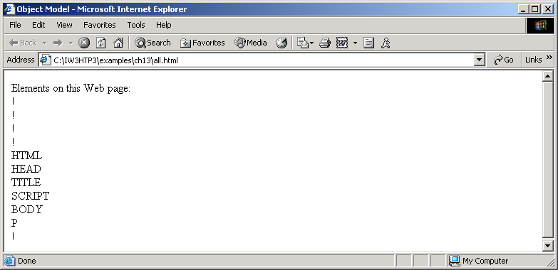
Outline
all.html (1 of 2)

Slide 24
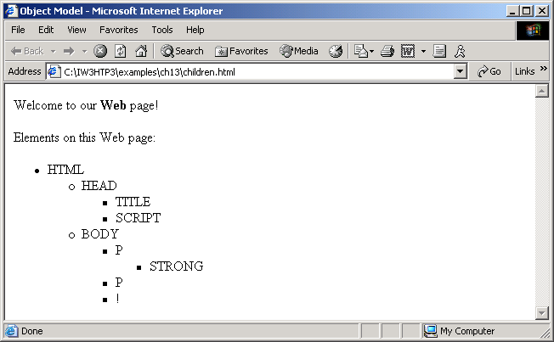
Outline

